Slide 1


SponsorSphere
Connecting Sponsors and Influencers
SponsorSphere is a comprehensive platform designed to connect sponsors and influencers, facilitating seamless collaboration between brands and influencers, streamlining the process of finding, managing, and tracking influencer marketing campaigns. This platform empowers brands with the tools they need to identify the perfect influencers for their campaigns, while providing influencers with opportunities to connect with brands that align with their values and audiences.
By: Azhar Quadri

Slide 2
The Digital Landscape: Influencers as Key Marketing Assets
Increased Reach and Engagement
Authenticity and Trust
Targeted Audience Engagement
Influencers have loyal followers, which allows them to effectively share brand messages, expand reach, and foster real engagement with audiences.
Consumers trust recommendations from influencers they follow, perceiving their endorsements as authentic and relatable, impacting purchase decisions.
Influencers cater to specific niches and demographics, allowing sponsors to target their ideal audience effectively and maximize campaign impact.

Slide 3

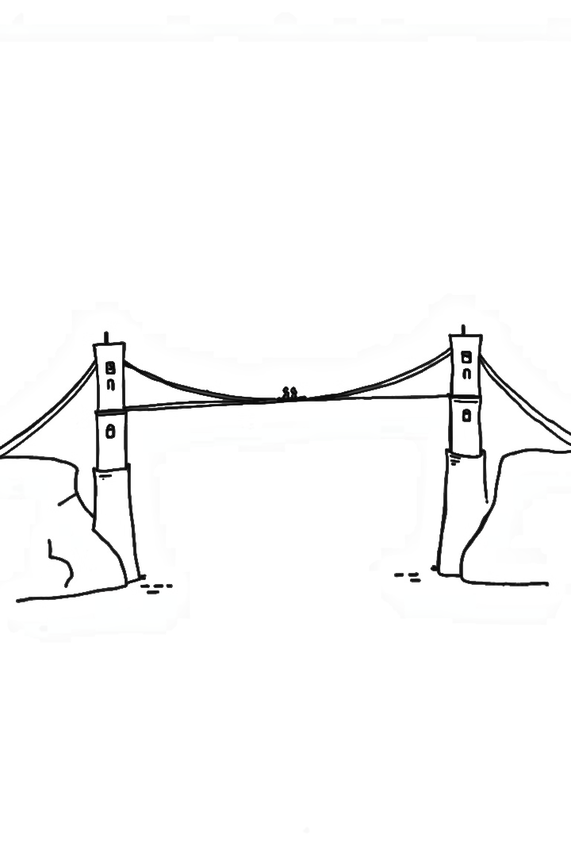

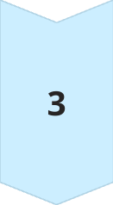
Bridging the Gap: Connecting Sponsors and Influencers
Sponsor Needs
Sponsors require a platform to discover, to connect with, and manage influencers for effective marketing campaigns.
Influencer Opportunities
Influencers seek a centralized platform to showcase their work, find sponsorship opportunities, and manage collaborations.
Streamlined Collaboration
SponsorSphere facilitates smooth communication, contract negotiation, and campaign execution between sponsors and influencers.

Slide 4
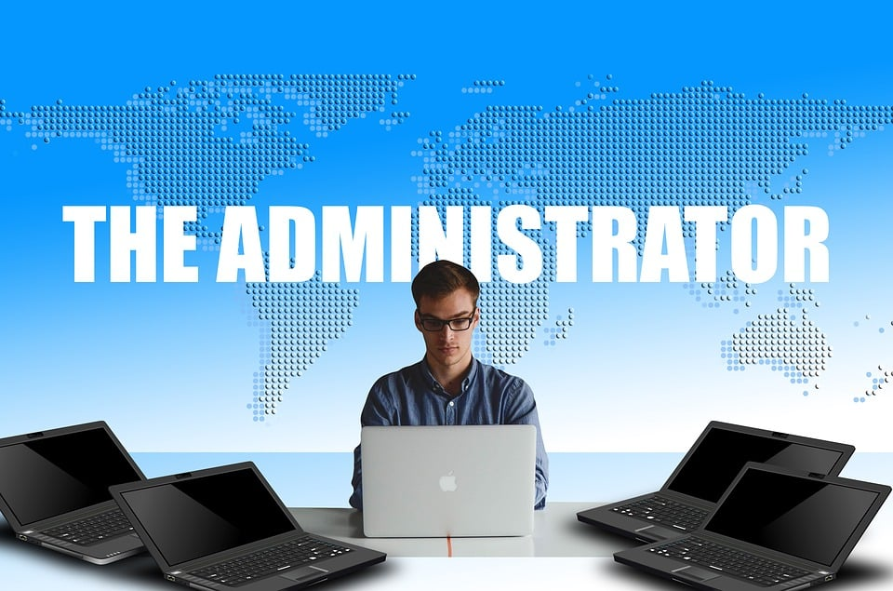


User Roles
Admin
Sponsor
Influencers
Admins with platform monitoring access
Sponsors managing Campaigns and Ad Request
Influencers engaging with ad requests

Slide 5

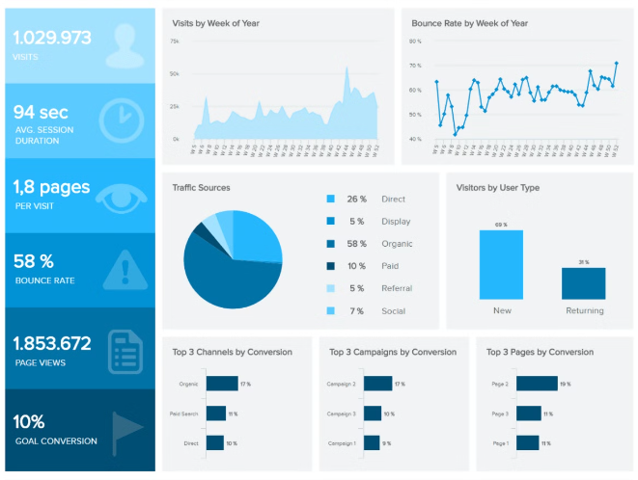
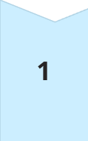


Functionalities: Campaign and Ad Request Management
Campaign Proposal
Sponsors can create and submit detailed campaign proposals, outlining their objectives, budget, and expectations.
Review and Negotiation
Influencers can review proposals, negotiate terms, and accept or decline ad-requests
.
Campaign Execution
Once accepted, the platform facilitates communication and metrics tracking for both parties.

Slide 6

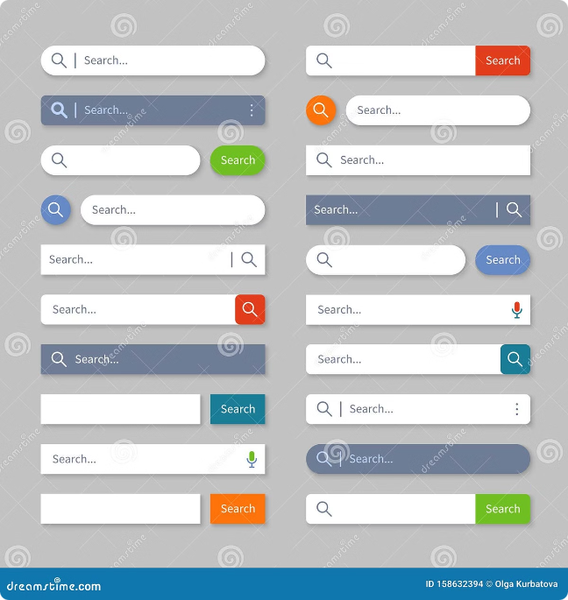



Search Functionalities
Keyword Search
Advanced Filtering
Filter influencers by relevant keywords, such as niche, audience demographics, and content style.
Narrow down searches by specific criteria like follower count, engagement rate, and location.
Hashtag Tracking
Identify influencers who frequently use specific hashtags relevant to your brand or campaign.

Slide 7
Technical Specifications
High-Level Architecture
Data Flow
The system will be built using a three-tier architecture comprising the client side (VueJS), server side (Django), and database (MySQL). The architecture ensures modularity and ease of maintenance.
Data will flow from the user interface to the backend server, where it will be processed and stored in the database. Responses will be sent back to the client for display.
1
2
3
Major Components
User Management: Handles registration, login, and role-based access.
Campaign Management: Manages the creation, update, and deletion of campaigns.
Ad Request Management: Facilitates the creation and negotiation of ad requests.

Slide 8

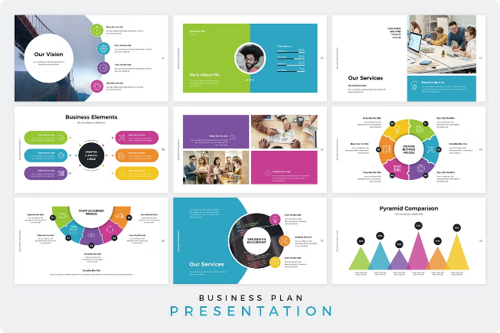
Feasibility: Technical, Economic, Operational
1
Technical Feasibility
Leveraging existing technologies with strong developer community support, the platform can be developed and implemented efficiently.
2
Economic Feasibility
The platform is economically feasible leveraging open-source frameworks making it financially viable and open to all.
3
Operational Feasibility
The platform can be effectively managed and maintained, with efficient customer support and user onboarding processes.

Slide 9
Advantages Over Existing Platforms
Focused Campaign Management
Cost-Effectiveness
Tailored Solution
Unlike LinkedIn, which lacks dedicated tools for managing campaigns, and Upfluence, which can be too complex for smaller campaigns, SponsorSphere offers a streamlined feature set tailored specifically for managing sponsorships from start to finish. This includes tools for handling ad requests and managing negotiations with ease.
SponsorSphere is designed to be accessible to both small businesses and individual influencers, offering essential tools without the premium price tag associated with Upfluence. This makes it a more viable option for a broader range of users.
Compared to the broader focus of Upfluence and LinkedIn, SponsorSphere offers a more tailored solution for influencer engagement and sponsorship coordination, catering to the specific needs of both sponsors and influencers.

Slide 10
Thank You

